Slide 1
Plant Physiology : lecture :(5) by Dr. Manal Zbari Photoperiodism
Photoperiod and Photoperiodis

Slide 2
Photoperiod
Word derivation:
Photo: light
Period: a specific length of time
Definition: the relative length of daylight and night
Photoperiodism
Definition: the response of plants to changes in the photoperiod
Example: flowering
The timing of flowering in plants is determined by the relative length of daylight and night (photoperiod).
The seasons are controlled by the length of daylight.
Between December and June, in the northern hemisphere, the amount of daylight increases daily.
So, increased daylight indicates spring and summer are on the way.
Between June and December, the opposite occurs.

Slide 3
The Maryland Mammoth and the Discovery of Short-Day Plants
Researchers: Garner and Allard at the USDA in the 1920s
Worked with the Maryland Mammoth, a large tobacco plant that didn't flower in the summer when most tobacco plants bloomed.
They discovered that the shortening days of winter stimulated flowering in the Maryland Mammoth.
Under controlled experiments, in light-tight boxes where they could manipulate the amount of light and dark, they discovered that flowering only occurred if the day length (amount of light) was 14 hours or less.
They called the Maryland Mammoth a short-day plant because it required a light period shorter than a critical length to flower.
Short-day Plants
Short-day plants flower when daylight is less than a critical length.
They flower in the late summer, fall, or early winter.
Examples: chrysanthemums (“mums”), poinsettias, some soybeans.

Slide 4
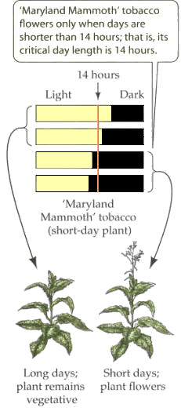
Unknown sources

Slide 5
Long-day Plants
Long-day plants flower when daylight is increasing.
They flower in the spring and early summer.
Examples: radishes, lettuces, irises, many cereal varieties.

Slide 6
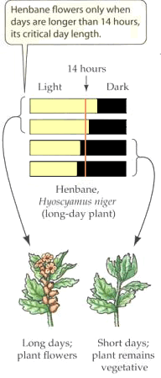
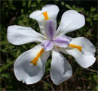
Unknown sources

Slide 7
Day-neutral Plants
Day-neutral plants do not flower in response to daylight changes.
They flower when they reach a particular stage of maturity or because of some other cue like temperature or water, etc.
This is the most common kind of flowering pattern.
Examples: rice, dandelions, tomatoes, etc.

Slide 8
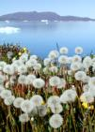
Unknown sources

Slide 9
In the 1920s, when they first did their research on the Maryland Mammoth, they thought it was all about critical day length.
For twenty years this was the prevailing understanding about how flowering was initiated.
All the biology books printed during these years talked about short-day plants and long-day plants.
But, in the 1940s, researchers discovered it was night length rather than day length that determined flowering.

Slide 10
It's All About Night Length, Not Day Length!
Key discovery: photoperiodism has nothing to do with day length—it is completely dependent on a critical night length.
Summary of research using the cocklebur plant:
The critical night length for the cocklebur is 8 hours: as long as the cocklebur plant has at least 8 hours of continuous darkness, it will flower.
What was originally called a short-day plant is actually a long-night plant.
If the night is punctuated by light for a few minutes, then it will not flower!

Slide 11
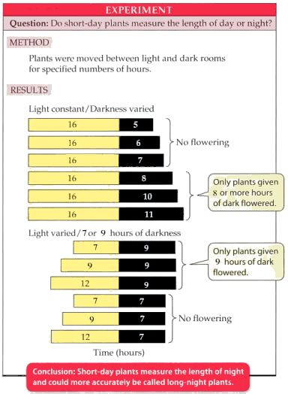
The Experimental Results

Slide 12
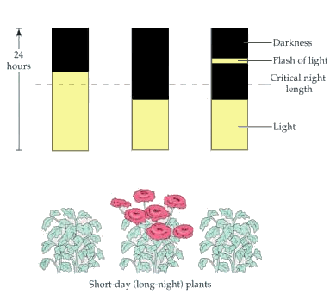
Unknown source; part of figure 39.16, page 766, Campbell's Biology, 5th Edition; unknown source

Slide 13
Long-day Plants are Actually Short-night Plants! Similarly, what were once thought to be long-day plants are actually short-night plants: they flower only when the night is shorter than a critical length. A few minutes of light during the night will shorten the night length, therefore causing flowering to occur!

Slide 14
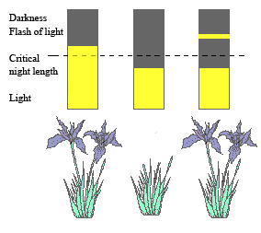
Part of figure 39.16, page 766, Campbell's Biology, 5th Edition
Part of figure 39.16, page 766, Campbell's Biology, 5th Edition

Slide 15
Flower Growers Use Knowledge About Photoperiodism to Make Money!
As your book mentions, the flower-growing industry uses this knowledge about how photoperiodism works to produce flowers out of season.
Chrysanthemums are short-day (long-night) plants that normally bloom in the fall.
Their blooming can be stalled until Mother's Day in May by exposing the plants to a little light during the long evenings.
This effectively shortens the night below the critical night length!

Slide 16
The Details Red light, of wavelength 660 nm, is the most effective in interrupting night length. Experimental results have confirmed this fact: Short-day (long-night) plants experiencing a long night will not flower if exposed briefly to 660 nm light sometime during the night. Long-day (short-night) plants exposed briefly to a 660 nm light will flower even if the total night length exceeds the critical number of hours.

Slide 17
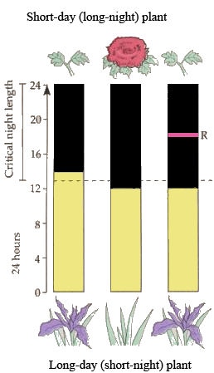

Slide 18
Far-red Light Cancels the Effect of Red Light
Shortening of night length by red light (R) can be negated by a flash of far-red light (FR) of 730 nm.
When this occurs, the plant perceives no interruption in night length.
No matter how many times red light is flashed, as long as it is followed by far-red light the effects of red light are canceled.
This works in both short-day and long-day plants.

Slide 19
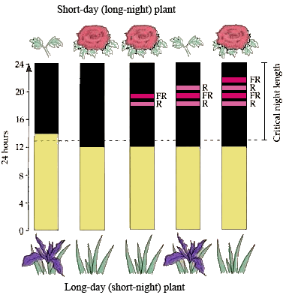

Slide 20
How Does This Work?
Light-sensitive proteins called phytochromes are partially responsible for the timing of flowering.
The phytochrome proteins come in two different forms: P_{r} and P_{fr}.
These phytochromes act as photodetectors that tell the plant what kind of light is present.
The absorption of light causes them to convert to the other form:
P_{r} absorbs red light to become P_{fr}.
P_{fr} absorbs far-red light to become P_{r}.
The presence of P_{fr} switches on physiological and developmental changes in plants.
Not only does it influence flowering, but also triggers other responses to light such as seed germination.

Slide 21
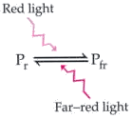
Unlabeled figure, page 768, Campbell's Biology, 5th Edition

Slide 22
Circadian Rhythms
Most plants and animals exhibit what are called circadian rhythms.
Word derivation:
Circa: approximately
Dies: day
“About a day”
Circadian rhythms are patterns of physiological change that follow a 24-hour cycle, day after day.
These 24-hour cycles can be seen in a variety of physiological responses and are very predictable:
Pulse
Blood pressure
Temperature
Rate of cell division
Metabolic rate
Stomata opening and closing

Slide 23
The big question in biology is whether these changes are controlled externally (by environmental cues) or whether they are controlled internally (endogenously).
The answer seems to be that they are controlled internally.
Scientists have put people and plants in darkness for days, and they still exhibit the 24-hour cycle.
However, the 24-hour cycle is no longer synchronized with the outside world—it drifts.
Take-home message: biological clocks exist, but they can drift.

Slide 24
The Phytochrome System Is a Way to Maintain the Circadian Rhythm
Since ordinary daylight has both red and far-red light, how does this system work?
The phytochrome is a homodimer (a quaternary protein with two identical halves), bonded to a non-protein light absorbing pigment called a chromophore.
The P_{r} form is constantly being synthesized by the plant.
When exposed to daylight, some of the P_{r} is converted to P_{fr}, but some P_{fr} is converted to P_{r} as well.
Eventually, equilibrium is reached and maintained during the day.
Degradative enzymes destroy more of P_{fr} than P_{r}.
In the dark, P_{fr} is converted to P_{r}.
At sundown, and throughout the night: P_{fr} begins to disappear and P_{r} accumulates.

Slide 25
At sunrise: P_{fr} levels suddenly increase, and P_{r} levels decrease.
Thus night length is responsible for resetting the circadian rhythm clock.

Slide 26
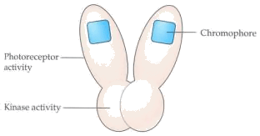
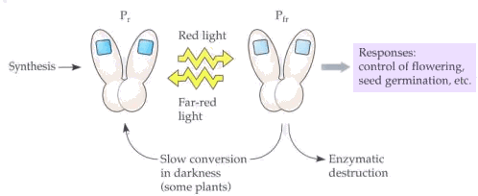
Figures 39.19 and 39.20, page 769, Campbell's Biology, 5th Edition

